Slide 1
Food Service Culture

Slide 2
we all have a favorite food item, memory, or remember the lunch lady being super sweet or super mean When thinking about the childhood experiences in the cafeteria

Slide 3
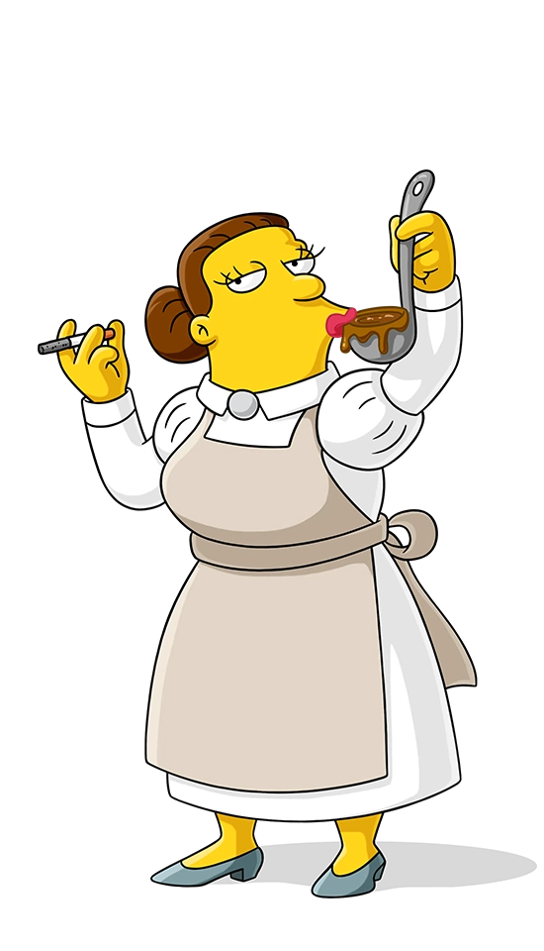
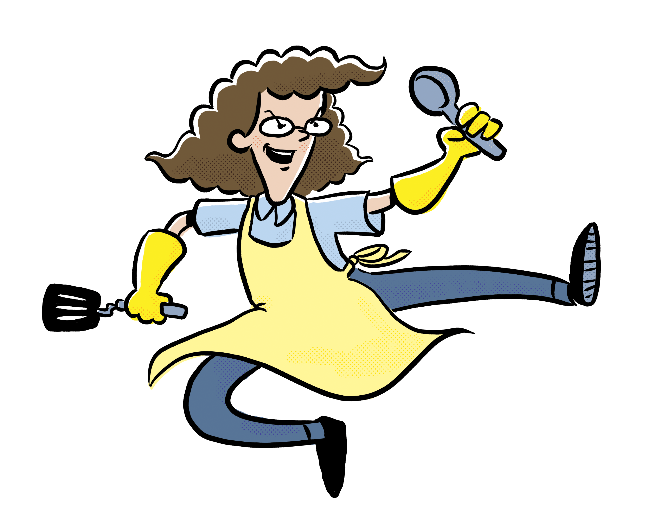
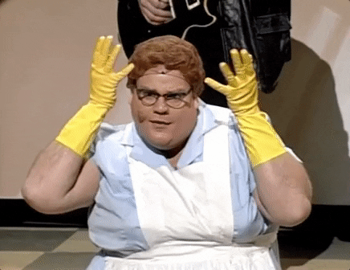
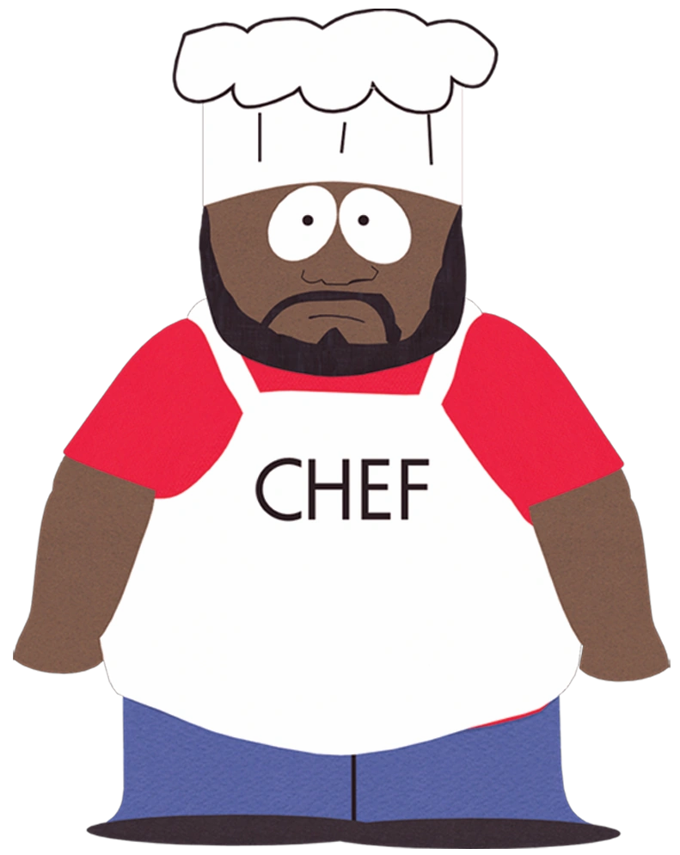
Famous Lunch ladies

Slide 4
Close your eyes: What do you see when you think of a stereotypical lunch lady?
ACtivity

Slide 5
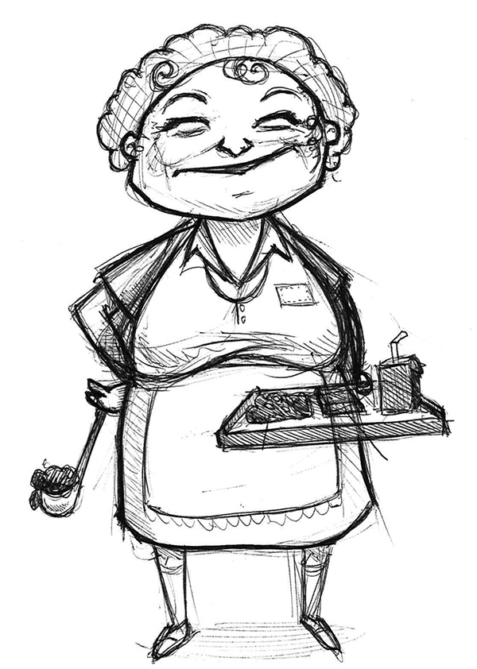
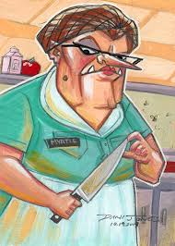
draw a lunch lady
*Enter to win a $25 Amazon gift card. Take a picture of your drawing and text it to 213-923-9631.

Slide 6
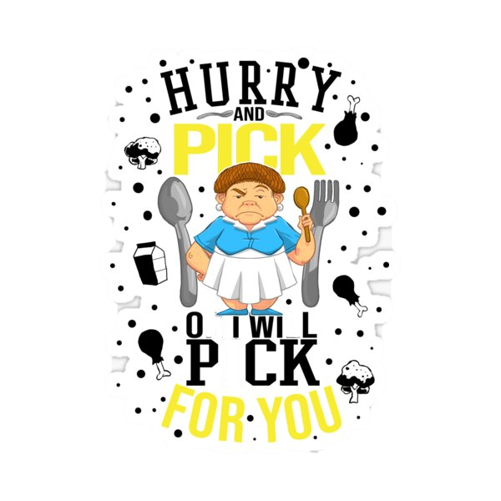
Mean Lunch Lady
Perception
Old
Not the best looking
Does not smile
Seems to not care for kids
Just there to do their job
This image of lunch ladies comes from movies, cartoons, and books, and even social media children see or read. In these shows and movies, the cafeteria staff is always in hair nets, doesn’t smile, just slaps food on the plate that doesn’t look appealing and yells. With this image people have in mind, misconception comes up that every lunch lady is like that.

Slide 7
M M M
practice
We want the child to leave with good happy memories and experiences

Slide 8
Make
MMM
Memorable
Moments

Slide 9
Be Our Guest

Slide 10
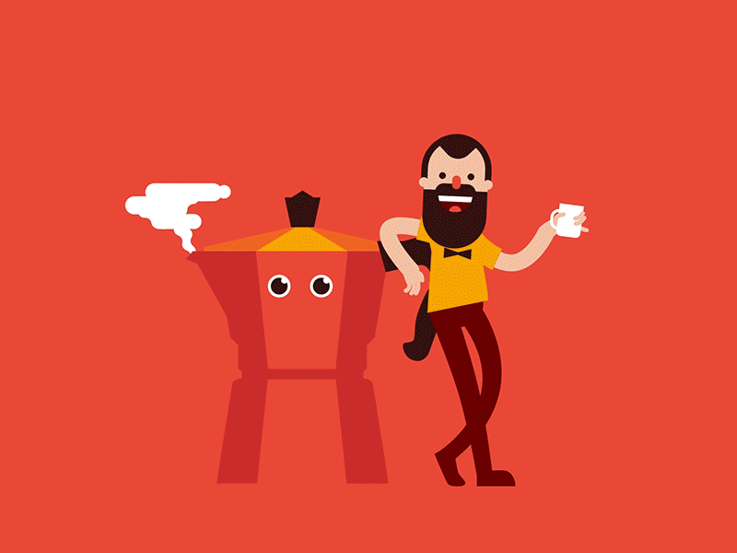
CELEBRATIONS
CHANGE OF SCENARY
Why do we visit food service establishments?
TAKE A BREAK
CONVENIENCE

Slide 11
Food service and hospitality-centric culture
Food service culture is defined as the attitudes, beliefs, and practices that surround the production and consumption of food.
Hospitality is the friendly and generous reception and engagement of guests, visitors, or strangers.

Slide 12
Balance act
When an employee focuses on the policies and procedures of the operation, the hospitality part of it lacks and there is no balance. The same is said for being too open and caring, then there now may be a threat to operational needs.

Slide 13
Inspired Service to make memorable moments
Inspire the team to be motivated to help others and create a friendly and courteous environment a way of life at our cafeterias.
Returning guests will feel valued and welcomed and the team gets satisfaction in knowing they have inspired others by leading by example.

Slide 14
Inspired service should be taken seriously by every employee, during every shift, and with every meal served

Slide 15
Café LA Break Away
What keeps you going back?
How can you create this environment in your kitchen?

Slide 16
Where do you find a cafeteria? What is your mindset when eating at these places?

Slide 17
Shifting to a Restaurant mindset
These establishments are not always pleasant and could be deemed cold and dark. Also, the customers are not there by choice in some cases.
Food Services Division, Café LA, is incredibly passionate about the customers and the experiences we create.

Slide 18
Not just a cafeteria, We are Café LA
Popular restaurants can be found in all neighborhoods and are identified by its iconic branded symbol.
The same can be said with Café LA and its logo. These restaurants are exclusive and service all students in the LAUSD community.

Slide 19
On-site restaurant located on 600+ campuses

Slide 20
Say the following phrases: I work in a cafeteria I work in a restaurant
ACtivity

Slide 21
Be our guests
Customers should be viewed as “guests” instead of as a number for a reimbursement.
Hospitality/restaurant mindset that goes beyond swift and friendly customer service
Enjoyable experiences for the guests
Quality food
Food service and hospitality balance

Slide 22
Remember me
If you want the customer to remember your product or brand, they must be engaged and impassioned by the interaction with the staff’s company.
The emotional purchase can be greatly influenced by the people serving and selling the food. For this reason, properly training your staff is critical to creating the appropriate culture.

Slide 23
Café LA Break Away
Have you been remembered by a prior student?
How did that make you feel?

Slide 24
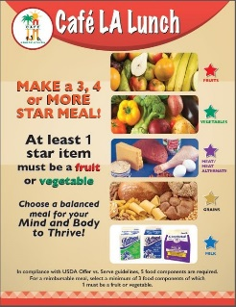
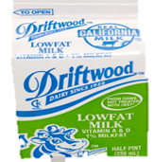
Opportunities to make memorable moments
Notes:
The students are receiving their lunch meals. Make sure you pay attention with the lunch meals numbers at the end of this service.

Slide 25
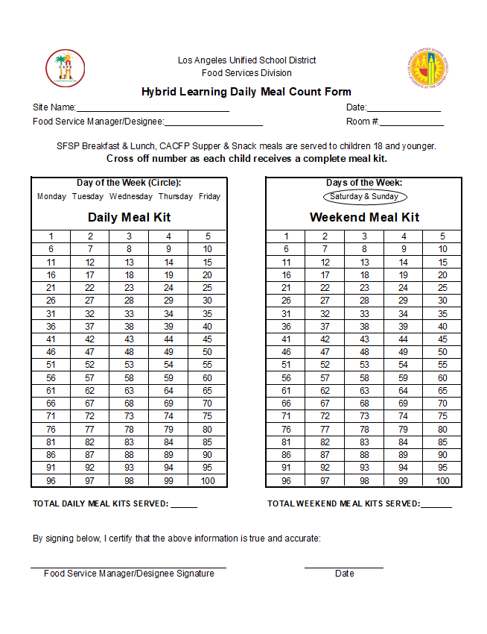
Start with the people

Slide 26
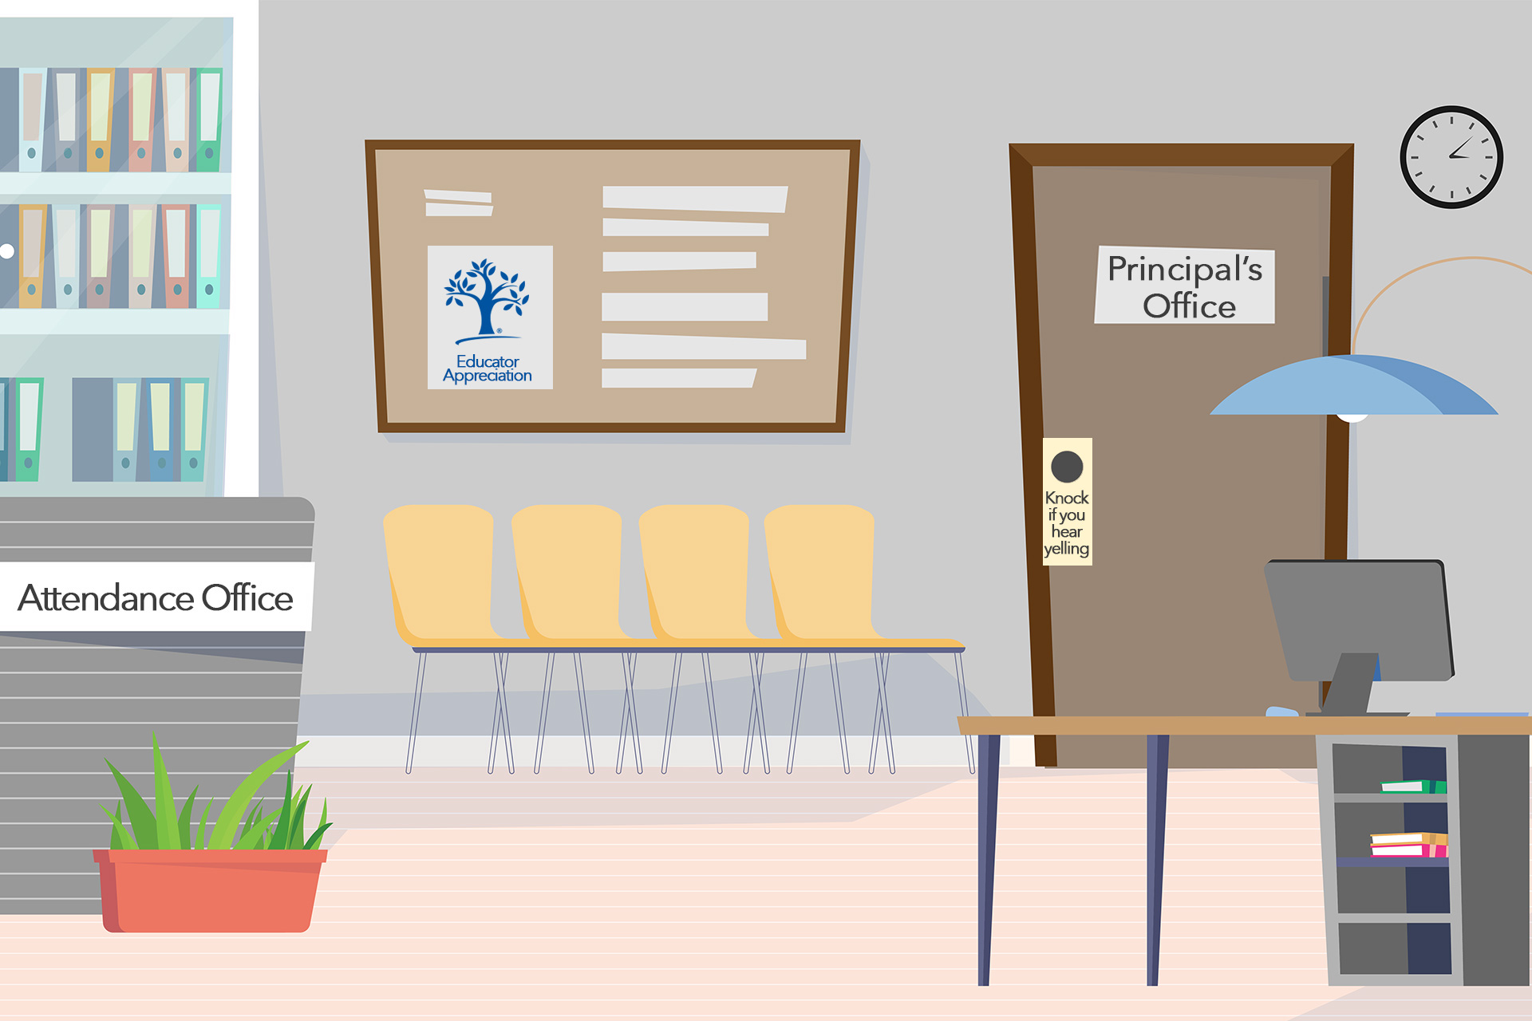

Slide 27
Executing the Culture
If the team is not a believer and fully engaged in the development of a foodservice culture, the business is sure to fail, and will not be active to create those memorable moments with guests.
Food Service Managers and staff are the ones who must effectively execute this essential culture at the customer-facing level.
They see and engage with you!

Slide 28
Review Impact on food service industry

Slide 29
Umm, did you really want to eat at this place?
My cousin’s girlfriend’s dogwalker said she had a horrible experience here!
Oh really? Everyone at work raved about it.

Slide 30
Thanks for meeting me here. It is my favorite place!
They have really great reviews online too!

Slide 31
The Power of The Reviews

Slide 32
Restaurant reviews
Positive Reviews indicate that the establishment offers amazing customer service, great atmosphere, and top-quality food.
Reviews influence 90% of customers buying decisions.

Slide 33
Café LA Break Away
Do you check reviews?
Has a review ever stopped you from buying something or eating somewhere?

Slide 34
Good service can make up for bad food, good food can not make up for bad service

Slide 35
Student perceptions
To achieve overall student satisfaction, the cafeteria must be exceptional in these areas:
Quality of food
Open options
Service quality
Ambience

Slide 36
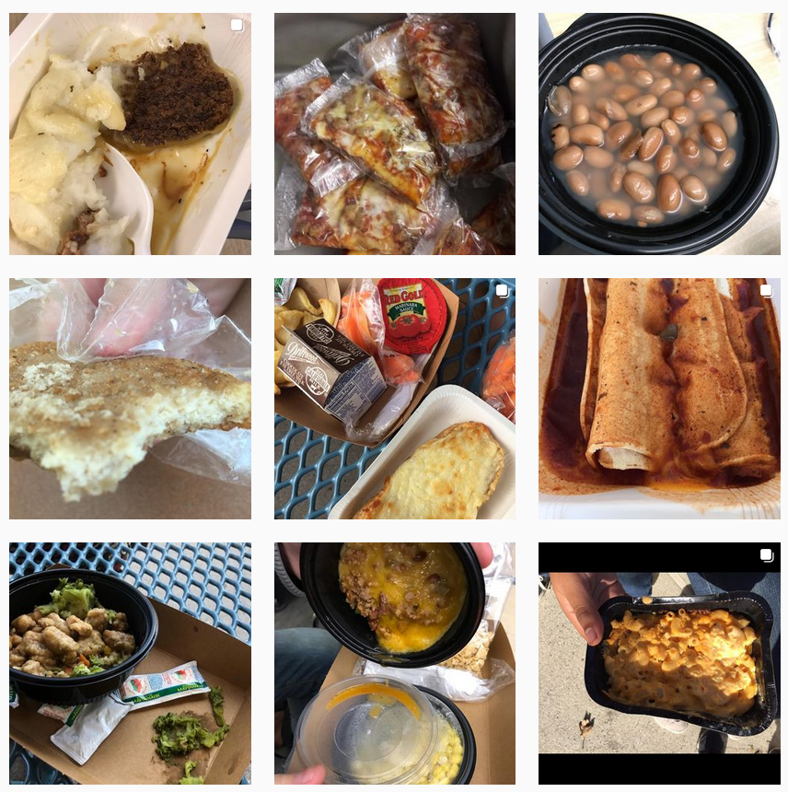
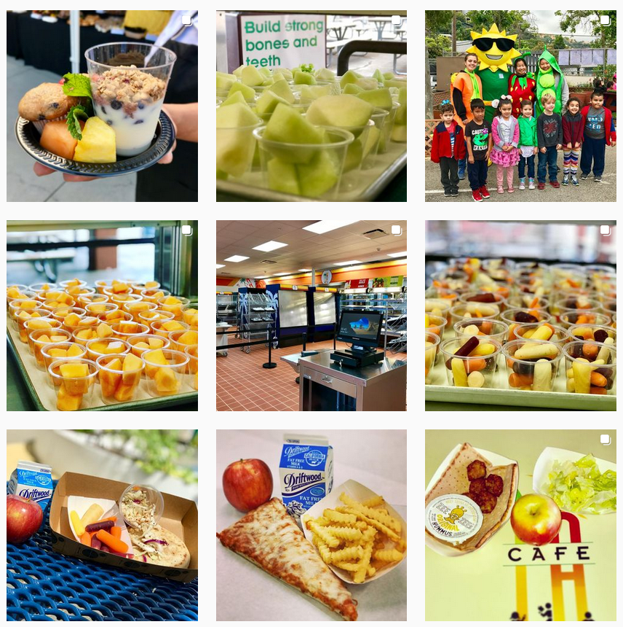

Slide 37
Serving up some
good ole
Customer service

Slide 38
Emotional Purchase
Food is an emotional purchase. It all comes back to that gut feeling you get when you think of your favorite dish, snack, beverage or brand.
You equate a specific emotion to an experience you had around food.
These emotions find a permanent home in your memory – only surfacing when you find yourself in a similar situation again.

Slide 39
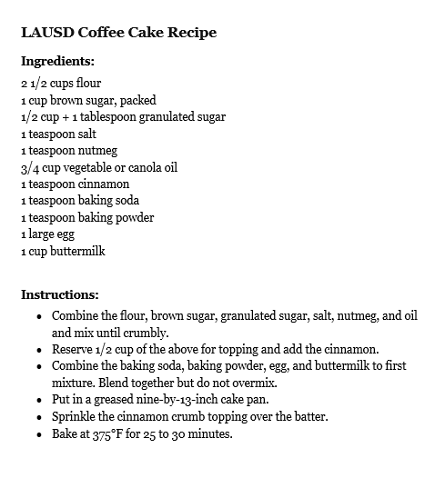
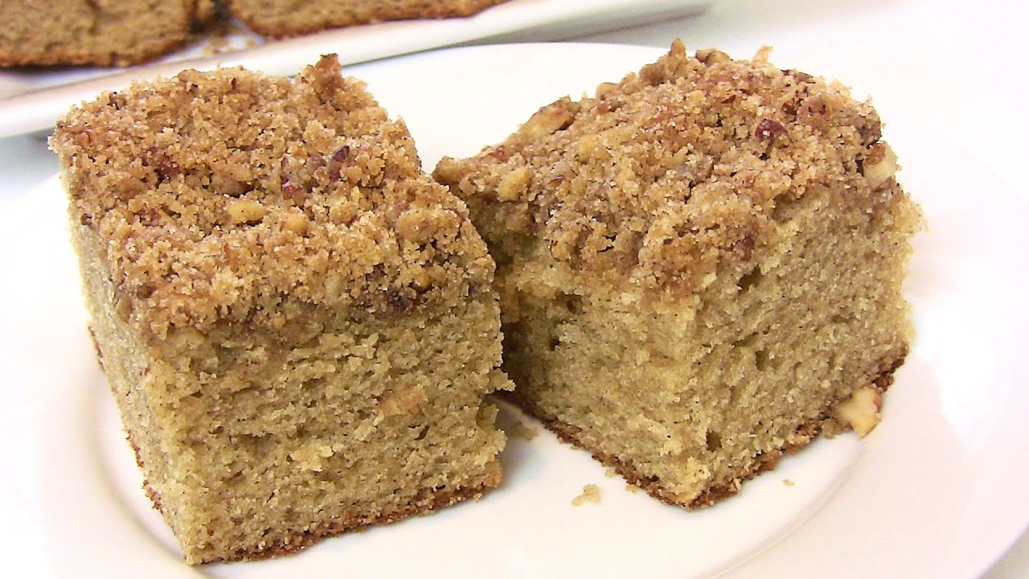
Emotional Purchase

Slide 40
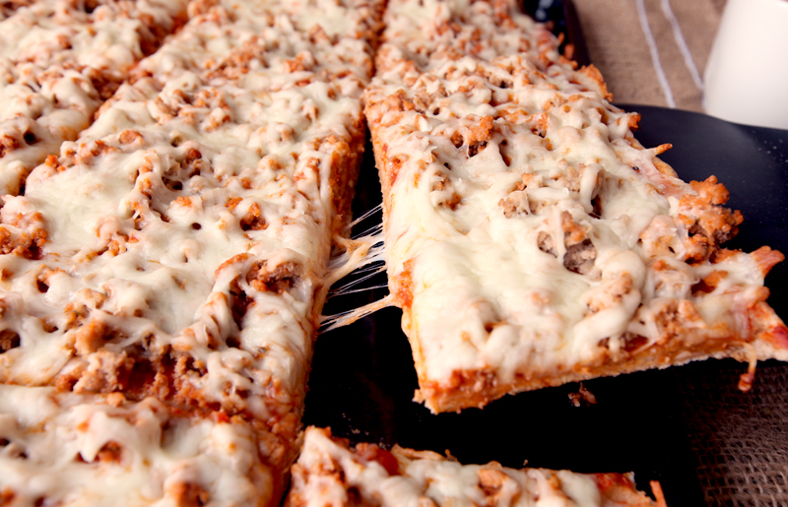
Emotional Purchase

Slide 41
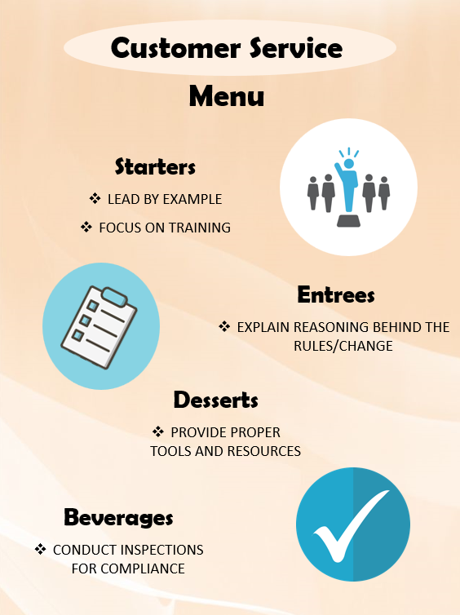

Slide 42
Lead by Example
Be the employee that you want to see your employees be:
Fosters a positive work experience
Build trust and respect
Increases productivity
Boosts employee morale and engagement

Slide 43
Focus on Training
Employee learning is a continuous process, much like the growth of the operation:
Communicate the purpose of training
Assess the training needs focusing on operational goals
Utilize resources from Café LA website
Will lead to continuing success and an open-learning culture

Slide 44
Explain Reasoning behind the Rules/Change
Communicate the “WHY”:
If employees are told the reasoning behind any instructions or tasks, they will be more prepared for the change
Allows opportunity for them to ask questions and gain clarifications

Slide 45
Provide Proper Tools and Resources
Allow employees to thrive and learn:
Sign at threshold; marketing
Reminders to smile when out in an area guests can see

Slide 46
Conduct Inspections For Compliance
Practice Active Managerial Control (AMC):
Be an ACTIVE manager
Get out of the office and walk the operational floor and service areas
Listen to employee interaction with customers
Do not overstep or intervene unless when necessary
Provide feedback to employee on a job well done and/or areas they can improve on

Slide 47
Create the food service culture you want

Slide 48
What is your culture now?
Have clear understanding of what your culture is now:
Practices, behaviors, and values that the company rewards
Mission statement and vision
Profile of the employees who make up your organization
What procedures and systems are in place today

Slide 49
Determine desired future state of kitchen
Seek clear vision of what you want your kitchen to be:
Clean and neat
Staff to be friendly and helpful
Organized
Inviting
Free of drama!!!

Slide 50
develop an action plan
Evolve the culture in your kitchen by developing an action plan:
Do your customers trust your kitchen?
Do you know enough about how your customers feel about your service?
Do they make connections with your staff?
Are you being transparent enough to earn trust with staff and guests?
How are you going to resolve any issues as they arise?

Slide 51
Continue to communicate the culture
Message must be reinforced by behavior and communication:
Heavily and consistently communicate the culture with staff and where it needs to be
Culture message can never be over-communicated
Pre-shift meetings, on-the-spot corrections, monthly safety and sanitation meetings, monthly communication messages, etc.

Slide 52
Do all the “Extras”
Chalkboard with jokes
Birthday board
Decorating for holidays
Matching attire (Café LA shirts, school spirit shirts, solid colors etc.)
Fun food facts
Display of lunch items
Taste tasting (with AFSS permission)
Participate in spirit days and other school functions (back to school nights, pep rally)

Slide 53
Café
Personalities

Slide 54
Doom & Gloom
Narrow-minded
Judgmental of others
Negatively effect others
Anxious

Slide 55
Bubbly & Nice
Very polite
Careful with wording and how they approach difficult topics
Makes sure everyone around them is having a good time
Surrounds themselves with positivity and enthusiasm

Slide 56
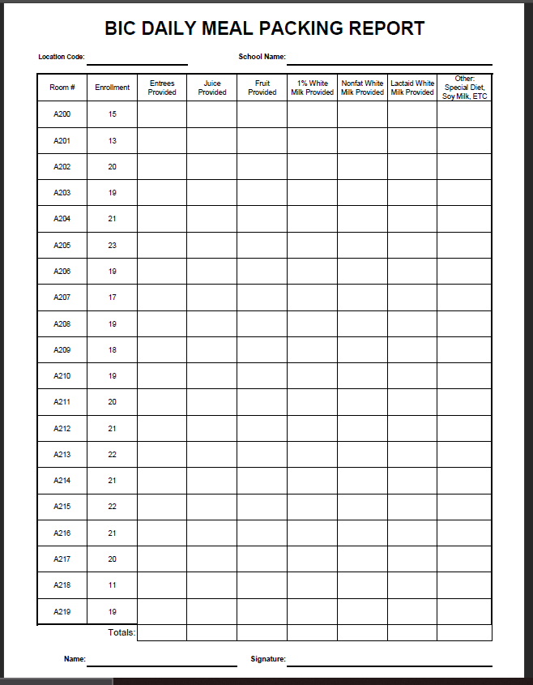
Quiet & unopinionated
Refrains from sharing opinions
Just there to do job
“Do your 8 and hit the gate”
“Do your 4 and nothing more”

Slide 57
Caring Mama/papa
Warm and welcoming
Good old-fashioned manners
Utmost respect for the social rules
Behave in exactly the way that is expected in every situation

Slide 58
Aggressive & Combative
Come across as more than a little intense
Defensive when asked about work production
Inflexible
Deemed difficult to outsiders

Slide 59
Know-it-alls
Strong belief in their own intellect and high level of self confidence
Rubs people the wrong way
Low emotional IQ

Slide 60
Café la break away
Do you have employees with any of these type of personalities?
Who do you want to work with?

Slide 61
cOmmon Ground
It is easy to identify the different personalities in the cafeteria; however, it is important to keep the focus on what matters the most:
Nourishing children to achieve excellence

Slide 62
cOmmon Ground
As food service employees in the restaurant/hospitality business, it is our duty to create an environment where children feel safe, comfortable, and free of any food insecurity thoughts.
When the cafeteria is pleasant:
Students eat more
Do better in their academic work
Have fewer behavioral problems
Feel more connected to their school

Slide 63
If children feel safe, they can take risk, ask questions, make mistakes, learn to trust, share their feelings, and grow
-Alfie kohn

